Slide 1
Thermal power generators (in Thermo, “heat engines”)

Slide 2
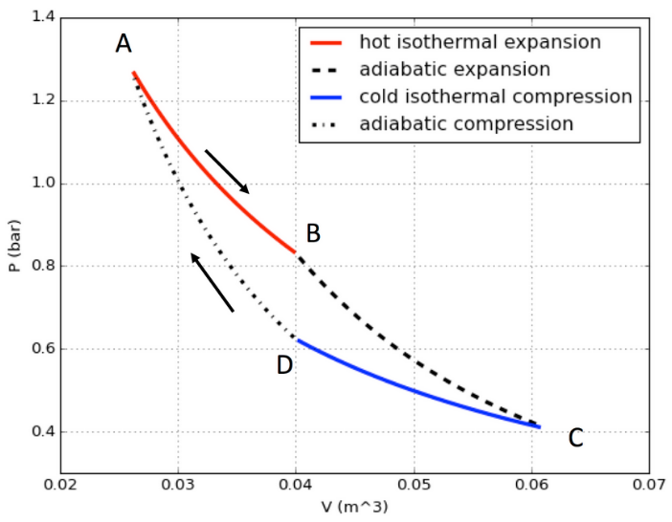

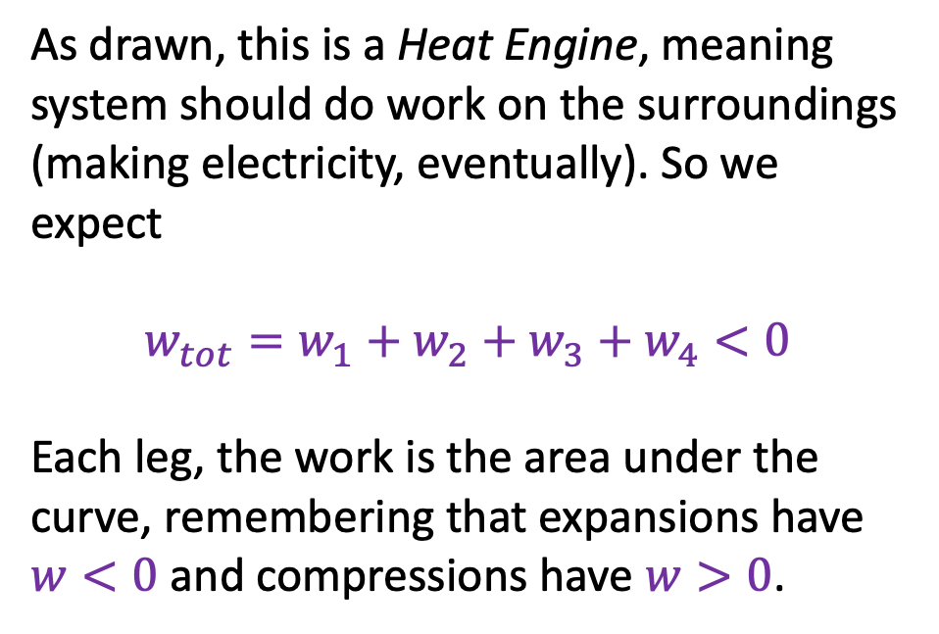



Thermal power generators (in Thermo, “heat engines”)
As drawn, this is a Heat Engine, meaning system should do work on the surroundings (making electricity, eventually). So we expect
$$w_{tot}=w_{1}+w_{2}+w_{3}+w_{4}<0$$
Each leg, the work is the area under the curve, remembering that expansions have $w<0$ and compressions have $w>0$.
$$w_{1}$$
$$w_{4}$$
$$w_{2}$$
$$w_{3}$$

Slide 3




Thermal power generators (in Thermo, “heat engines”)
The cost of running our power generator/heat engine is the fuel required to pour heat into our working gas during the hot isothermal expansion leg.
$$q_{1}$$
$$q_{4}=0$$
$$q_{2}=0$$
$$q_{3}$$

Slide 4
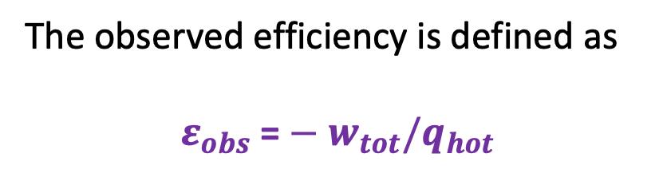
Thermal power generators (in Thermo, “heat engines”)
The observed efficiency is defined as
$${ε_{obs}\text{ =}−w}_{tot}/q_{hot}$$

Slide 5
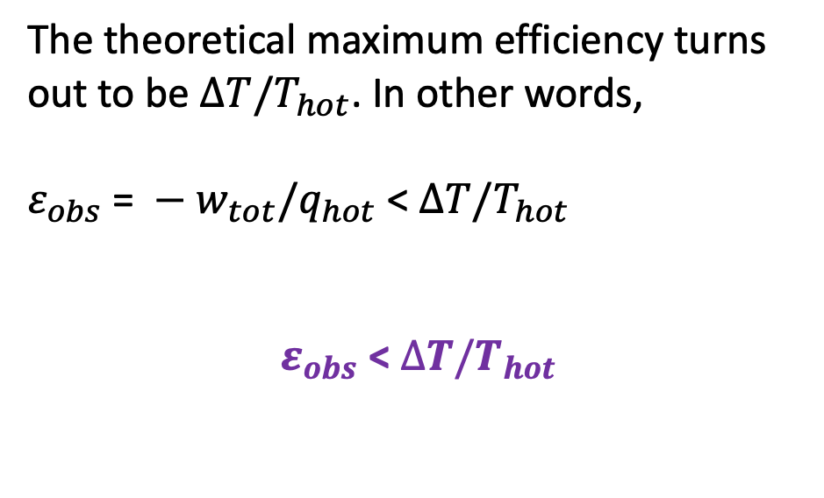
Thermal power generators (in Thermo, “heat engines”)
The theoretical maximum efficiency turns out to be $∆T/T_{hot}$. In other words,
${ε_{obs} \text{= }−w}_{tot}/q_{hot}$ < $∆T/T_{hot}$
$ε_{obs}$< $∆T/T_{hot}$
$$q_{1}$$
$$q_{4}=0$$
$$q_{2}=0$$
$$q_{3}$$

Slide 6
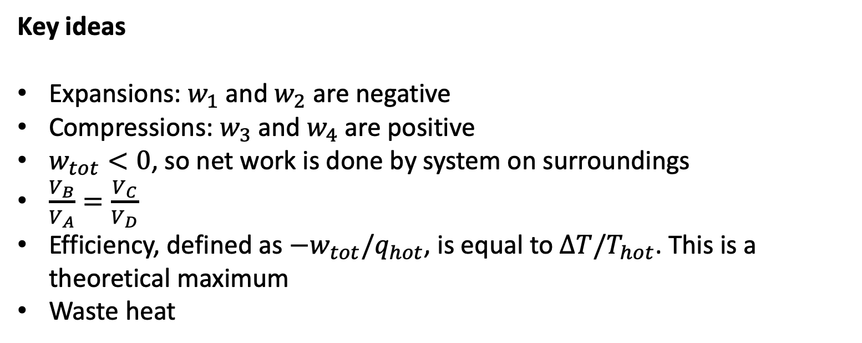
Thermal power generators (in Thermo, “heat engines”)
Key ideas
Expansions: $w_{1}$ and $w_{2}$ are negative
Compressions: $w_{3}$ and $w_{4}$ are positive
$w_{tot}<0$, so net work is done by system on surroundings
$\frac{V_{B}}{V_{A}}=\frac{V_{C}}{V_{D}}$
Efficiency, defined as ${−w}_{tot}/q_{hot}$, is equal to $∆T/T_{hot}$. This is a theoretical maximum
Waste heat

